Slide 1
Risk in Financial Services
CISI Exam Revision Course - Edition 11
Notes:
These slides have been put together to provide the basis for an exam revision course for the Chartered Institute for Securities & Investment’s Risk in Financial Services examination. Please adapt to you own delivery style and the audience.
The slides are intended to provide the content needed for a revision course designed to prepare candidates for sitting the exam. They assume that the candidates will have already undertaken some studying and are attending an intensive course designed to prepare them for their final revision prior to the exam.
These slides are based on the syllabus effective from 11th August 2022 and the 9th edition of the supporting workbook.

Slide 2
Objective of the Qualification
The objective of the examination is to ensure that candidates have a broad understanding of the following:
The general principles of risk in business
The key risks that arise within the financial services industry
The influence of corporate governance, regulation and codes of conduct
The approaches that are typically used to identify, reduce and manage specific aspects of risk

Slide 3
Workbook Chapters
Principles of Risk Management
International Risk Regulation
Operational Risk
Credit Risk
Market Risk
Investment Risk
Liquidity Risk
Model Risk
Risk Oversight and Corporate Governance
Enterprise Risk Management (ERM)

Slide 4
Principles of Risk Management
Chapter 1

Slide 5
Risk management
The practice of using processes, methods and tools for quantifying and managing risks and uncertainties
Identifying what could go wrong
Evaluating which risks should be dealt with
Implementing strategies to address those risks
Risk versus uncertainty
Risk is the variability that can be quantified
Uncertainty is the variability that cannot be quantified

Slide 6
Risk in Financial Services
Credit, market and liquidity risk
Investment risk
Operational risk
Enterprise risk
Strategic risk - Internal and External
Corporate governance and risk oversight
Notes:
Briefly review all risk types. All will be considered in further detail in the remaining chapters

Slide 7
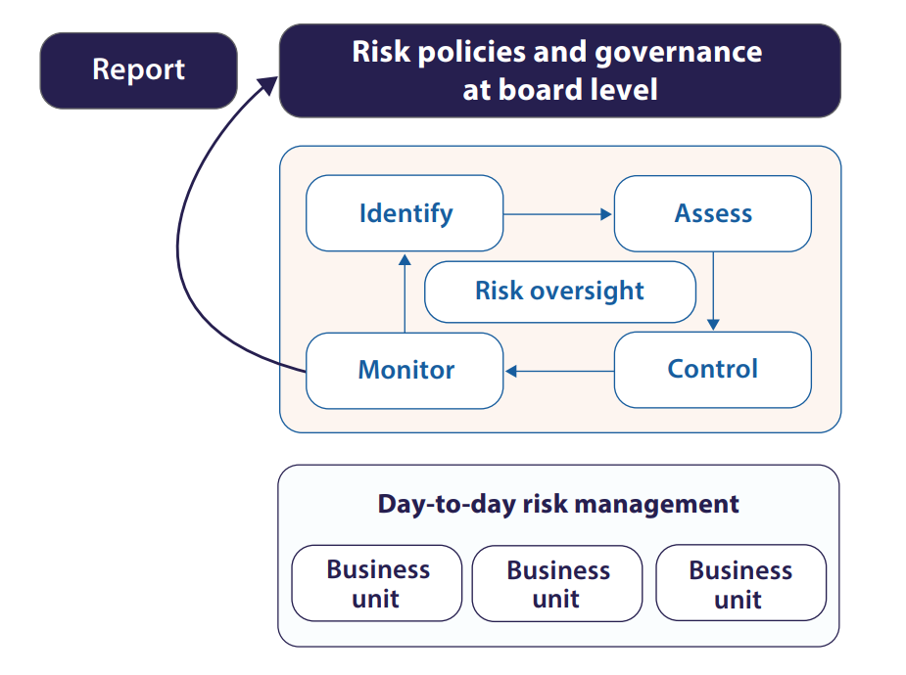
Elements of a Risk Framework

Slide 8
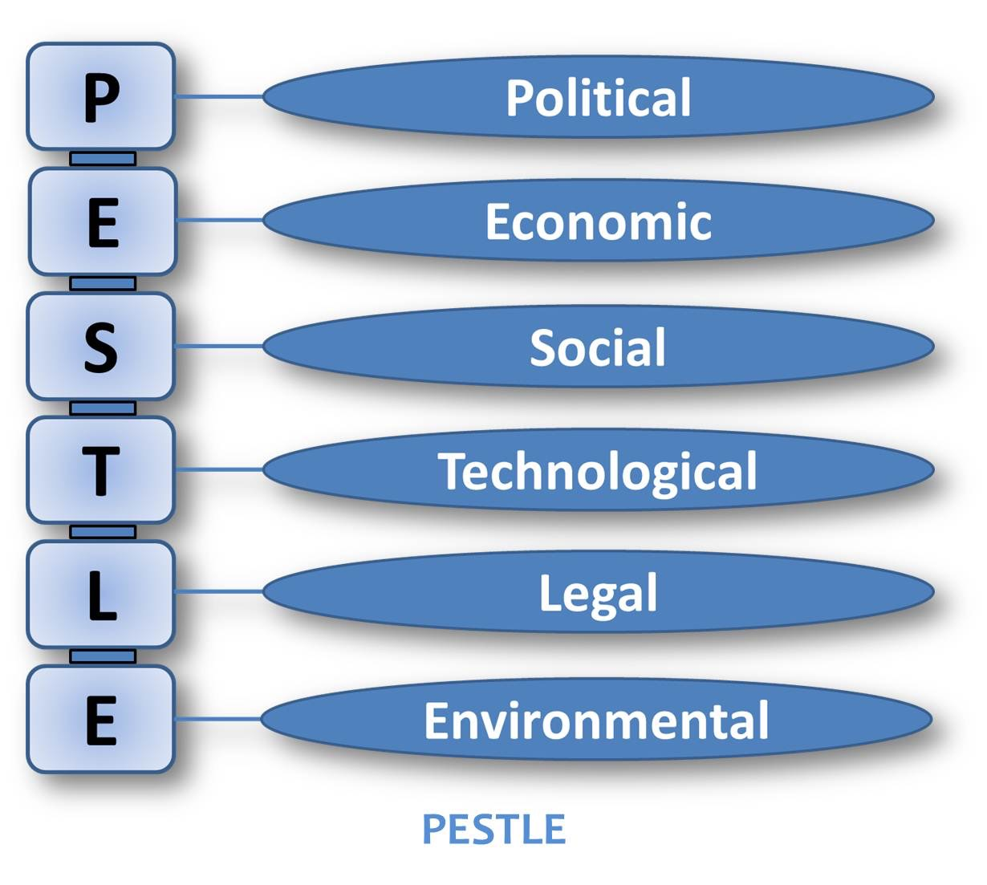
Assessing External Risks - PESTLE analysis
Notes:
the PESTLE analysis is an important tool in assessing external risks. The individual component type risks are covered in next set of slides. Briefly highlight each of the elements. Purpose of PESTLE analysis is to assess the macro economic environment in which the business operates

Slide 9
External Sources of Risk
Economic
Political
Competitive environment
Social and market forces
Technological and Cyber Security Risk
Shocks and natural events
External stakeholders and third parties
Environmental, Social and Governance risks (ESG)
Notes:
Highlight how these changes can impact financial services (see workbook chapter 1, section 1.2)
Economic - impact of economic downturn or growth
Political - changes in government and laws
Competitive environment - Particularly the performance of other companies in the same sector
Social and market forces - Changes in the propensity to save, or the attitude to credit
Technological and Cyber - Growing reliance on and acceptability of the internet
Shocks and natural events - For example, the events of 9/11, Covid-19 pandemic (ref workbook section 1.2.5 for chart on global learning delay)
External stakeholders and third parties - Examples include decisions made by the parent company, the influence of institutional investors and large customers
ESG – variety of sources including climate change, depletion of natural resources, human capital, product liability, corporate governance
All these are examples. Use other, local examples as well to highlight the importance.

Slide 10
Assessing External Risks – Other
Business Continuity Planning
Planning for disaster recovery and business continuity will uncover external risks
Business Process Analysis involving
Examination of each high-level business process
Description the internal processes and external factors that can influence those business processes.
Notes:
Business process analysis can, for example, be undertaken on the basis of a risk hierarchy:
Assigning probability ratings, the ‘likelihood score’ (eg very low = 1 through to very high =5)
And impact ratings, the ‘impact score’ (eg very low potential loss = 1 through to very high = 5)
Risk score = likelihood score x impact score

Slide 11
Key Internal Risk Drivers
Strategic risk
Is the strategy right?
Is the strategy properly implemented?
Operational risk
The risk of loss arising from processes, people, systems or external events
Financial risk
Credit risk
Market risk
Liquidity risk
Notes:
EBA definition of strategic risk is: ‘the current or prospective risk to earnings and capital arising from changes in the business environment and from adverse business decisions, improper implementation of decisions or lack of responsiveness to changes in the business environment’ Use any local regulator’s definition if available
BIS defines operational risk as ‘the risk of loss resulting from inadequate or failed internal processes, people, and systems or from external events’

Slide 12
Assessing Internal Drivers of Risk
Risk assessment workshops
Discussion with external auditors
Stress testing
Scenario analysis
Notes:
Stress testing - vary one input factor at a time observing the impact. For example an increase in house prices of 15%
Scenario analysis - consider a set of realistic scenarios for example a change in economic growth of +2%
Illustrate with examples

Slide 13
Overlapping Nature of External and Internal Drivers
External and internal risk drivers often overlap
Example: development and launch of new products
Internal risks include strategic, operational, compliance and financial risks
External risks include the economic climate and the competitive environment
Possible methods to reduce new product risk
Gap analysis
Market survey
Research and development
Notes:
Internal and external risk drivers cannot fully be seen in isolation
Highlight other examples as well as ways to reduce risk

Slide 14
Concepts of Risk
Risk culture and conduct risk
Risk appetite
Inherent (gross) risk
Residual (net) risk
Risk profile
Risk mitigation
Reputational risk
Notes:
Risk culture needs to be carried throughout the organisation from top down in order to be successful.
Risk culture and conduct risk:
The system of values and behaviours throughout an organisation shaping risk decisions
Conduct risk: Risk that the firm’s behaviour will result in poor outcomes for customers
Risk appetite - aka ‘risk tolerance’, the level of loss the firm is willing to accept over a specified time horizon. can be addressed top-down or bottom up
Inherent risk aka ‘gross risk’, assessing risk without the mitigating controls
Residual risk aka ‘net risk’, exposure after taking into account mitigating controls
Risk profile: Outline of the risks to which the firm is exposed
Risk mitigation: Efforts made to reduce the impact and/or likelihood of the risk
Include examples to explain the concepts

Slide 15
Adding Value
Cost/benefit analysis - actual cost vs likely revenues
Include potential risks when assessing new strategies/products
Involvement in early stage of product development
Reduce likelihood of unexpected outcomes on day-to-day basis results in reduction of earnings volatility and enhance firm’s share price
Notes:
For new business, the company always undertakes a cost-benefit analysis to ensure the project is worth undertaking. Benefit has to exceed cost.
Risk needs to be included in the cost-benefit analysis as it may have an impact on overall profitability
Involvement of risk department in early stages will help assessing risks and potential mitigation techniques

Slide 16
Specific Risks in Financial Services
Bank for International Settlements defines the following:
Operational risks
Credit risk
Market and asset liquidity risk
Funding liquidity risk
Interest rate risk
Systemic risk:
Risk to one firm can affect stability of whole financial system
Recovery and resolution plans required
Notes:
Highlight each of the types of risk with an example.
Operational risk - risk of failing operations. Does not include reputational risk
Credit risk - risk that a counterparty does not repay
Market and liquidity risk - risk of market movements
Funding liquidity risk - inability to obtain funding
Interest rate risk - risk associated with interest rate movements
Recovery and resolution plans (UK) require to lay out credible recovery actions and mechanisms to enact failure in an orderly fashion. Use local examples to highlight.

Slide 17
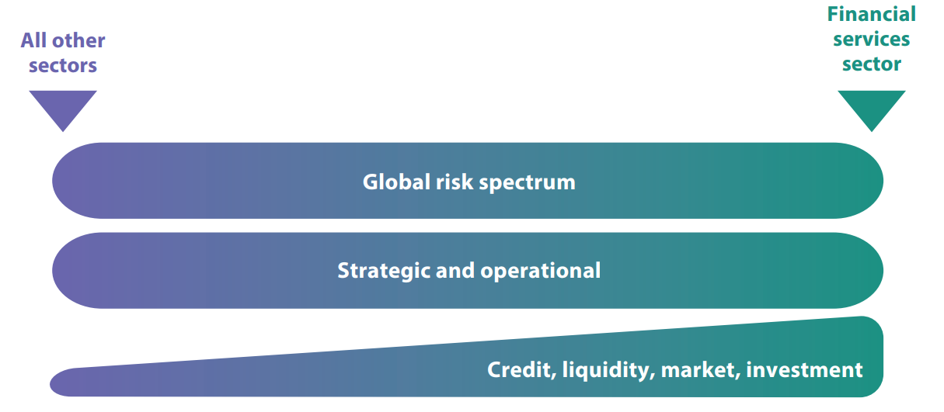
Risk in different industries
Notes:
Recovery and resolution plans (UK) require to lay out credible recovery actions and mechanisms to enact failure in an orderly fashion. Use local examples to highlight.

Slide 18
Emerging Risks in Financial Services
Technology in finance and regulations
Digital Assets, Cryptocurrencies and Smart Contracts
Financial crime
Cyber and data security
Custody
Market risk
Business and reputational risks
Notes:
Technology – fin tech (use of technology to improve the efficiency of financial processes), RegTech (use of technology to improve financial regulations),
Crypto assets (currency and other assets, block chain technology)
Technology results in different types of financial crime
Technology results in different risks including changes in market risk, reputational risk

Slide 19
International Risk Regulation
Chapter 2

Slide 20
Bank for International Settlements
Established in 1930
Bank of central banks
International monetary and financial co-operation
Headquartered in Basel in Switzerland
Regulatory guidelines do not have force in national or international law
Countries can choose to implement via law and/or regulations
Notes:
EU, for example, implements the Basel accords and guidelines into EU laws with individual countries incorporating these in their own laws.

Slide 21
Basel Committee (BCBS)
Enhance understanding of supervisory issues and improve the quality of banking supervision worldwide
Basel Accords – 3 pillars
Minimum calculation of capital
Firm’s own view on capital adequacy and supervisory review
Public disclosures

Slide 22
Basel Committee (BCBS)
Standards on capital adequacy to ensure firms hold enough capital to overcome adverse movements
Additional concepts beyond capital adequacy (Basel IV)
Countercyclical capital buffer
Leverage ratio
Liquidity requirements/ratios

Slide 23
Core Principles
National preconditions to provide a framework for effective supervision
Sound and stable macro economic policies
Framework for financial stability policy formulation
Public infrastructure
Framework for financial crisis management. recovery and resolution
Systemic protection or public safety net
Effective market discipline
29 Core principles
1-13: Supervisory powers, responsibilities and functions
14-29: Supervisory expectations of banks, emphasising importance of good corporate governance and risk management
Notes:
Candidates do not need to know the individual principles as LO states ‘understand’. Go over principles using examples

Slide 24
Basel Regulatory Capital
Sound practice principles
Covering a range of aspects of risk management
Practical guidance for firms
Specific areas for regulators to address in supervisory role
Pillar 2 Assessment - Internal Capital Adequacy Assessment Process (ICAAP)
Firm’s risk exposure
Firm’s view on adequacy of its risk management processes
Firm’s financial and capital plans
Stress and scenario tests applied to risks and financial plans
The firm’s capital and liquidity adequacy
“Use-test”
Setting the regulatory capital and liquidity level
Notes:
Firm’s capital and dividend plans need to be compared to aggregate results of risk assessments.
ICAAP has to be embedded within the firm - Use test
Once ICAAP is completed, regulator will set amount of capital a firm must hold based on ICAAP and discussions between regular and firm
ICAAP is the firms own assessment of its capital requirement and the adequacy of its risk management processes and procedures. Will be used buy the regulator as input to the assessment of the capital required y the firm

Slide 25
Home Host State Regulation
Multi jurisdiction supervision
Home state: Home or parent regulator
Host state: Regulators in countries where the firm has branches
Parent banks and supervisors are ultimately responsible
Key principles
Supervision by home supervisor
Cross border institution needs to have approval from home and host
Home countries have information gathering rights
Host may impose restrictive measures

Slide 26
Principles-based regulation
Rules based or statutory approach – based on specific legal rules, eg US SEC
Principles based regulation specifies general types of behaviour expected
National regulator responsibility
Day-to-day regulatory relationship with firms
Regulate for the risk a firm presents to the regulator’s statutory objectives
Risk Management and Control
Consumer protection
Business standards
Regulatory standards
Notes:
Highlight using UK examples from work book,but also use local examples.
Consumer protection - treat customers fairly, ensure transparency. Management of conflicts of interest.
Business standards include client communication, client asset guidance, market conduct, training and competence
Regulatory standards - Supervisory standards and disciplinary activities
Regulatory reviews may be done off-line (desk based) and in person

Slide 27
Reviews and Risk Assessment Visits
Baseline monitoring activities:
Analysing financial and other returns
Generally assessing management, governance and culture, control functions, capital and liquidity
Supervisory intensity based on risk impact and probability scores
For firms with significant retail or wholesale businesses:
Customers
Products
Markets
For firms with permission to hold or control client money:
Arrangements for safeguarding
Notes:
Supervisors typically have baseline monitoring activities that apply to all institutions under their jurisdction. In addition, a supervisory intensity depends on the risk the firm poses to the stability of the financial industry in the country

Slide 28
Other relevant regulation
Effects of breach of law
Reputational risk
Withdrawal of regulatory authorisation (sanction)
fines and penalties
Criminal and civil liability
Loss of staff
Identify all relevant laws
Mitigate risk of inadvertently breaking the law
Notes:
Use a recent example of a breach of law and the implications on the firm(s) involved.

Slide 29
Operational Risk
Chapter 3

Slide 30
Basel Committee Operational Risks
Definition: ‘The risk of loss resulting from inadequate or failed internal processes, people and systems or from external events’
Includes legal risks, but excludes reputational risk
Risk event types
Internal fraud (IF)
External fraud (EF)
Employment practices and workplace safety (EPWS)
Clients, products and business practices (CPBP)
Damage to physical assets (DPA)
Business disruption and system failures (BDSF)
Execution, delivery and process management (EDPM)
Notes:
Operational risk typically considers both the potential size of the loss and the chance of it occurring. For example, company branded pens being taken by staff and customers are high occurrence, low loss. The failure of an IT system is low occurrence, high loss.
see table on chapter 3, section 1.2 for description of each of the risk event types

Slide 31
Operational Risk
Relatively difficult to identify and put a value to
Operational Risk as a Distinct Risk Class
Operational risk materialises, often causes other risk issues too:
Reputational risks
Compliance (or regulatory) risks
Credit risks
Market risks
Liquidity risks
Investment risks
Notes:
Elaborate on each of the risk types and how they interact. Consider using publicly available examples.

Slide 32
Operational Risk Policy
Document outlining the firm’s strategy and objectives for operational risk management
Identification of key officers
Define clear roles and responsibilities
Segregation of duties
Cross-functional involvement and agreement
Operational risk management function
Identification and assessment of risk
Risk management and mitigation techniques
Benchmarking good industry practice
Provide risk oversight and monitoring
Ensure issues are escalated
Conduct quantitative/statistical modelling on risk events
Statistical modelling
Notes:
Operational risk policy outlines the framework for consistent and coherent approach to operational risk management
Key officers are those that are important for the running of the company and are not restricted to Sr. management
Roles and responsibilities need to be clear and include accountability
Management of risk includes the reduction of potential impact and the likelihood of occurrence
Statistical modelling enables quantification of the impact of operational risk on the firm

Slide 33
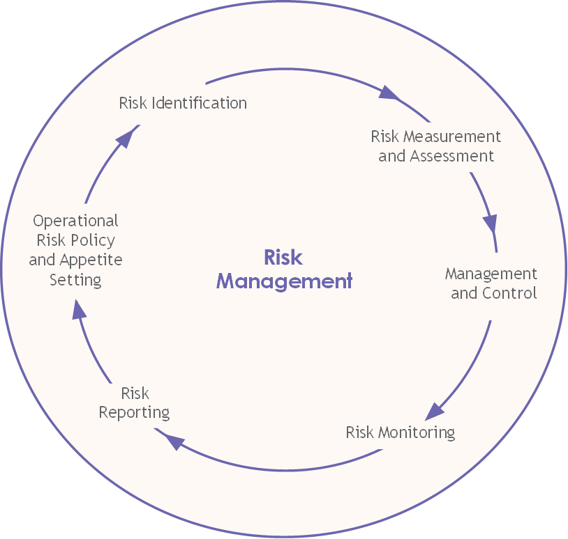
Operational Risk Management Framework
Notes:
Risk management comprises all activities in the circle, starting with risk identification, ending in ensuring the risk is managed appropriately in the operational risk policy. It’s a continuous process with periodic reviews needing to take place.
Use an example related to a recent public (local) case. Equally, IT systems failing could be used as an example.

Slide 34
Operational Risk Identification
Identifying and categorising operational risks helps the firm establish their risk profile and appetite for risk
Risks are typically categorised as follows:
Process risks eg, lack of written procedures or absence of escalation procedures
People risks eg, inadequate definition of roles and responsibilities or staff not competent for the role
System risks eg, denial of service attacks, or data corruption
Vulnerability to external events eg, threat of terrorist action or customer fraud
Self assessment – departmental managers and staff score risks
Subjective
Individual risk scores to be combined in a single final score
Notes:
Use other examples of the different risk categories to bring the subject to life. For process risk, for example, a missing control could be causing issues. People risk also relates to staff being inadequate or not appropriately educated for the job they have
Systems risks is related to cyber attacks as well as system unavailability for other reasons such as system failure.
Using categories enables the organisation to assess the appropriate mitigation techniques and to communicate the risk across the organisation. In addition, it forms a basis for capital allocation
Self assessment needs to be independently verified.

Slide 35
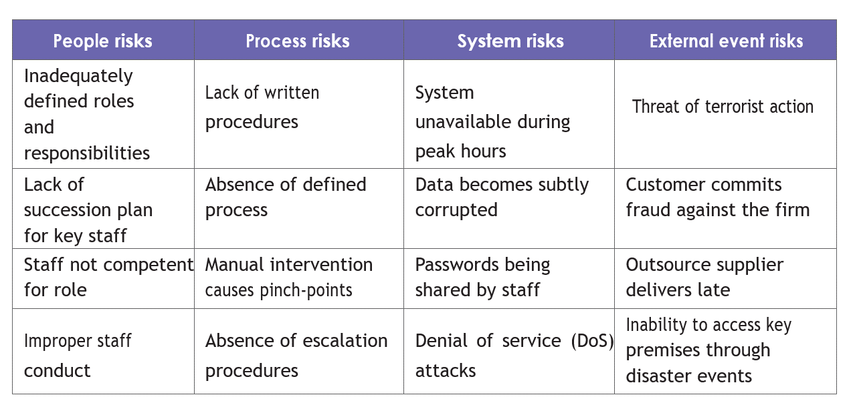
Application
Notes:
Discuss additional types of risks for each of the categories. Create a bespoke example as case study work for participants

Slide 36
Operational Risk Assessment and Measurement
Understanding the likelihood of risks occurring and the potential impact on the business
Establishes a quantitative baseline for improving the control environment
Major difficulty is the lack of relevant and objective data
Risk measurement
Uses quantitative techniques to understand the size of a firm’s or business area’s risk profile
Risk assessment
Estimates the impact on the business
Uses objective and/or subjective data
Notes:
Understanding he likelihood of a risk occurring also assists in developing a strong risk culture as well as satisfying regulatory requirements

Slide 37
Methods of Assessment
Impact and likelihood assessment
Likelihood probability
1 = very low, 2 = low, 3 = medium and 4 = high
Impact loss rating
Impact is the potential loss such as under £1,000 = 1, £1,000 to £10,000 = 2, £10,000 to £50,000 = 3, over £50,000 = 4
Risk Score
Likelihood score x impact score
Notes:
Engage candidates by asking them for examples from their experience and rate them to see how they compare
Risk score can be represented in a heat map (see next slide)
Explain advantages of the method including simplicity, evaluation tool, focus on important risk, can be used with minimal data, covers wide range of risks. See p 67 of workbook

Slide 38
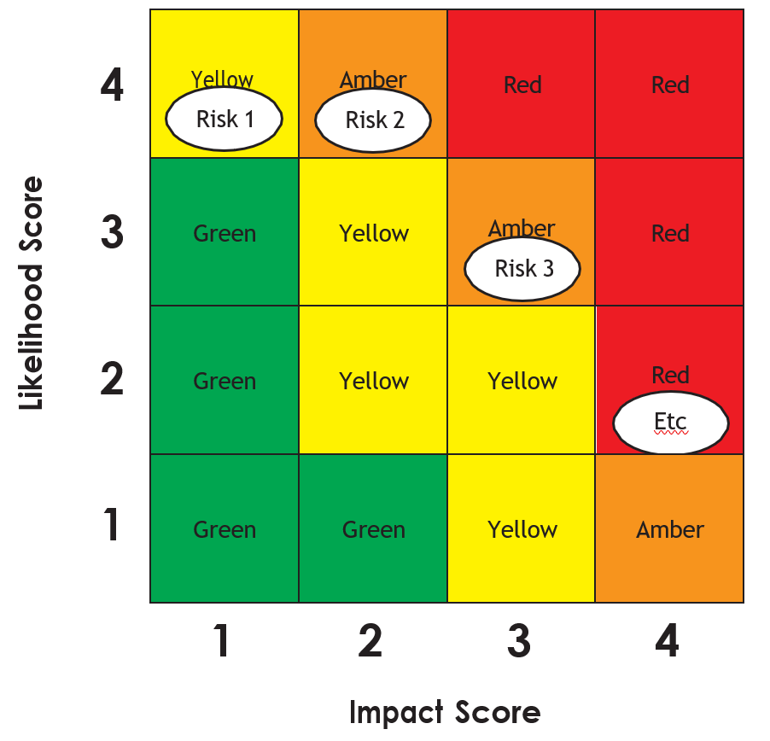
Heat Map of Risk Ranking

Slide 39
Scenario and Bottom-up
Scenario Analysis
‘Top down’ method
Uses experience of business professionals to capture possible scenarios
Scenarios are investigated, and preventative measures can be taken
Bottom up analysis
Builds up a detailed profile of the risks that occur in each area
Aggregates them to provide risk exposures for departments, divisions and the whole firm
Uses a combination of experience of the managers and staff along with loss data
Resultant measure contains both qualitative and quantitative elements
Notes:
Scenario analysis is further assessed in chapter 8. Give example of possible scenario such ac GDP decline of 0.5% and house price decrease of 15%. What would the impact be
Discuss advantages and disadvantages of the bottom-up analysis (see chapter 3, section 5.3.3 of the workbook)

Slide 40
Key Risk Indicators (KRIs)
Method of measuring operational risk
Taking the key risks from the operational risk assessment and identifying indicators
Indicators will ideally be forward looking and predictive
Identify periods of increased operational risk before losses start occurring
Notes:
Use the example on chapter 3, section 5.4 to discuss in-depth
Advantages of KRI are that they allow for the monitoring of trends, setting of limits and provide a basis of objective risk measurement.
Disadvantage is mainly that they may cause skewed business performance.

Slide 41
Historical Loss Data
Important in mapping actual losses experienced back to the categorisation system
Allows for creation on loss distribution curve
Analysis to predict future losses within specified confidence limits
Shape of the curve is often fat tailed and not normally distributed – extremely high impact losses occur very rarely
Notes:
Curve shows on next slide
Give examples of low risk/high occurrence and high risk/low occurrence

Slide 42
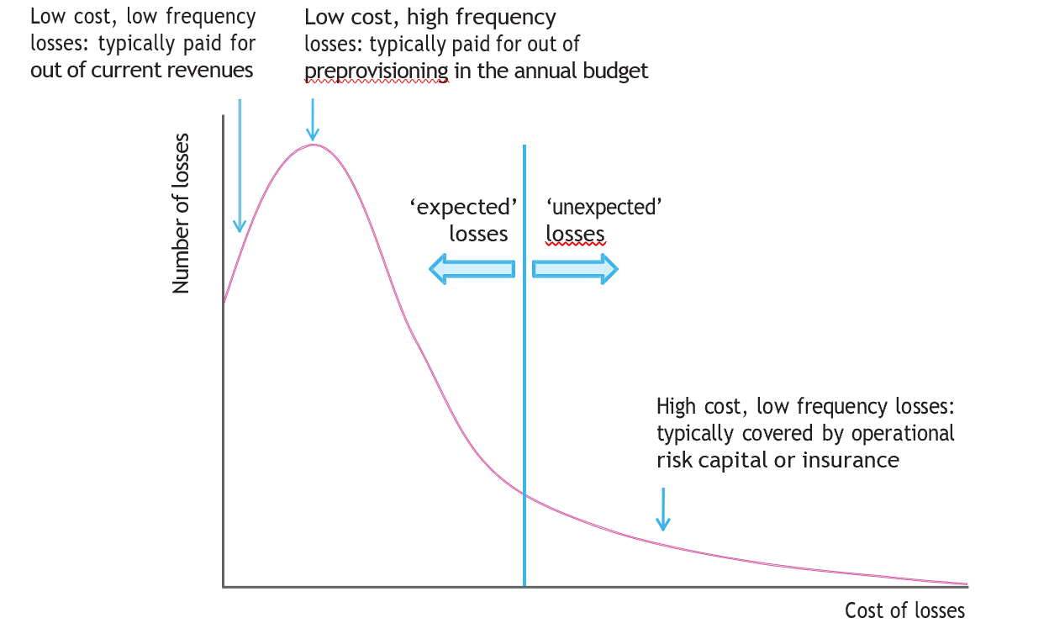
Historical Loss Data – Loss Distribution Curve

Slide 43
Practical Constraints
Data collection constraints
Lack of data, system constraints and lack of standardisation make it difficult to build a comprehensive data set
Cultural constraints
Business heads need to be convinced of the value
Resource and cost constraints
Firms commonly underestimate the time and resource requirement
Indicator constraints
Difficult to design risk indicators that monitor the full range of risks

Slide 44
Risk Register
Also known as Risk Log
List of risk identified including part of business
Assign owners to each risk
Define risk mitigation
Period re-evaluation of risks on the register and the effectiveness of the risk mitigants

Slide 45
Managing Operational Risk
Transfer to third party
Avoid
Mitigate
Accept
Notes:
Transferring risk to a third party can be achieved by insurance or outsourcing (see later)
Some risks can be avoided by, for example, withdrawing from a business, changing a product offering or not taking on new business
Some risks can be mitigated via control processes et.
Some risks are worth accepting and managing the impact should be materialise

Slide 46
Operational Risk Mitigation
Controls
Financial Crime Prevention
Operational Resilience
Outsourcing
Insurance
Information, Cyber Security, Data Protection and Privacy
Physical Security
Financial Reserves
Risk Awareness Training
Notes:
Controls are in place to check and re-check the process as it develops. Use local examples
BCP - premises and people, DR - IT and other infrastructure. BCP and DR need to be subject to regular testing and relate, for example, to fire and power failures
Outsourcing may be subject to regulatory requirements and the institutions remains ultimately responsible
Insurance can cover many issues, need to ensure cost is proportionate to benefit
Use examples of malware, phishing etc. Include recent examples
Physical security is related to vetting and access to buildings
Risk awareness is a strong mitigant. People who understand the risk and are aware are more likely to spot risks as they may occur
Data protection – touch on GDPR and penalties

Slide 47
Operational Loss Data
Measurement
Escalation thresholds
Loss Causal Analysis
Understanding of the underlying causes of the loss
Address route cause will ensure the issue has a lower likelihood of recurring
Notes:
Escalation thresholds ensure issues are dealt with at the right level of the organisation.
Loss Causal analysis is also included in the Basel Accord.

Slide 48
Credit Risk
Chapter 4

Slide 49
Credit Risk
Risk of loss caused by the failure of an obligor to meet its obligations
Main types of credit risk
Counteparty risk
Issuer risk
Concentration risk – risk resulting from uneven distribution of exposures
Individual issuers
Industry sectors
Geographical locations
Systemic risk
Break down of the entire financial system
Notes:
Obligor is the party holding the financial obligation to repay
For banks the main form of Credit risk is the risk that a customer does not pay back their loan (counterparty risk)
Issuer risk is, for example, the risk that a bond issuer does not pay a coupon or principal
For more examples use chapter 4, section 1.2 of the workbook
Other forms of credit risk include when a company the bank deals with is declared bankrupt prior to paying for goods or services provided or when a broker fails to deliver a bond on time (or at all)
Concentration risk to individual issuers is also known as single-name concentration. Concentration risk occurs because the bank’s portfolio is not well diversified. Herfindahl-Hirschman Index (HHI)

Slide 50
Credit Risk Measurement
Credit exposure – the amount that can potentially be lost if a debtor defaults
Current exposure
Potential future exposure
Credit risk premium – difference between the interest rate paid by a firm and the rate paid on a default risk free security (eg government bond)
Credit rating – expression of a firm’s credit–worthiness and financial health, often by an independent credit ratings agency
Notes:
Current exposure is the exposure the bank has at this point in time. Potential future exposure considers credit facilities and financial instruments with potentially different future values
Higher rating means the client is more credit-worthy and more likely to repay. Typically a client with a higher rating pays a lower risk premium
More on credit ratings on the next slide

Slide 51
Key Credit Rating Agencies
Fitch Ratings
Moody’s
Standard & Poor’s (S&P), and
Dominion Bond Rating Service (DBRS).
Notes:
Current exposure is the exposure the bank has at this point in time. Potential future exposure considers credit facilities and financial instruments with potentially different future values
Higher rating means the client is more credit-worthy and more likely to repay. Typically a client with a higher rating pays a lower risk premium
More on credit ratings on the next slide

Slide 52
Merits and Limitations of Credit Ratings
Useful in assessing credit risk of companies worldwide – combination of sovereign and individual company/issue ratings
Focus on credit quality and do not capture other risks such as declines in market value or liquidity
Credit rating is an opinion
Specific criticisms include
Slow speed of downgrading
Inherent conflict between issuer paying for the rating and the impact on the cost of finance
Errors in ratings, especially for complex products
Notes:
Sovereign ratings take into consideration the overall economic conditions of a country
Generally speaking the rating of a company in a specific country is capped by the sovereign rating of the country

Slide 53
Counterparty Credit Risk
PD estimated using historical experience and empirical data
EAD depends on time to completion of loan arrangement and undrawn commitments
Other side of the LGD is the recovery rate (RR = 100% - LGD)
Credit limits used to limit exposure to individual borrowers, counterparties and groups
Notes:
EAD is the amount a bank will be exposed to in the future at the point of potential default. Includes an estimate of future lending before default. Expressed as a percentage

Slide 54
Counterparty Credit Risk
Wrong Way Risk - Risk that occurs when the exposure to a counterparty is adversely correlated with their credit quality
Non-performing assets - Loans for which repayments are not made on time
Credit Limits at different levels
Individual borrower
Groups of connected counterparties
Transaction types
Industries
Geography
Notes:
Loans for which repayments are not made within 90 days are typically non-performing. Up to 90 days, they are classified as past due

Slide 55
Limitations of Credit Risk Measurement
Simplified calculations of potential exposures
Lack of recognition of the time period of credit risk
Lack of recognition of portfolio diversification
Probabilities are a ‘best guestimate’
Notes:
See workbook, chapter 4, section 2.

Slide 56
Credit Risk Protection and Mitigation
Underwriting standards – to evaluate credit-worthiness
Guarantees
Credit limits
Netting – reduce multiple cash flows to just one
Collateral – asset(s) held as security in the event the client does not repay
Diversification – reducing portfolio credit risk by spreading exposures
Insurance/credit derivatives
Credit default swaps – resembling an insurance contract
Loan sales, securitisations and collateralised debt obligations – selling loans or creating special purpose vehicles (CDOs) to securities loans to bond investors
Central counterparties – guaranteeing all transactions to protect clearing members from default
Notes:
For an example of netting see chapter 4, section 3.1.4.
Collateral needs to be revalued periodically to make sure it is still valid. See examples in chapter 4, section 3.1.5. Add local examples. Candidates will need to be able to calculate collateral adequacy - see example on p 95.
For CDOs see examples next slide and in chapter 4, section 3.1.7.

Slide 57
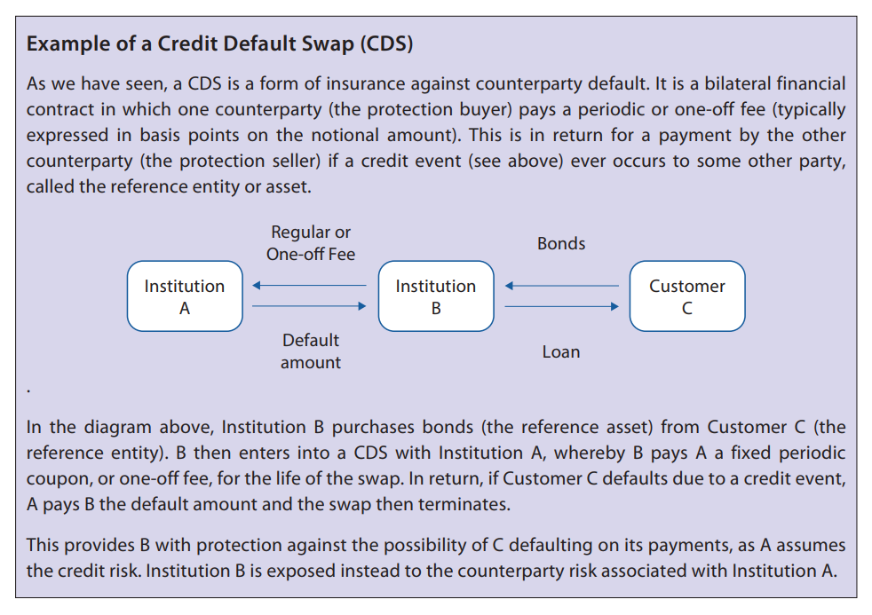
Example of a Credit Default Swap

Slide 58
Credit Risk Management
Setting, monitoring and reviewing credit limits
Assessing potential credit risk events
Ensuring decisions on granting credit are made independently of the trading areas
Measuring and monitoring daily credit exposures
Performing credit analysis
Reporting and escalation to senior management
Notes:
Credit risk management is responsible for ensuring the bank’s credit risk is appropriately managed within the organisations’s risk appetite
Credit risk management does not own any of the risks

Slide 59
Basel Key Stages
Board of directors should approve and periodically review (at least annually) the credit risk strategy and significant credit risk policies
Senior management implement and develop policies and procedures for identifying, measuring, monitoring and controlling credit risk
Measurement of credit risk should take into account
Specific nature of the credit
Exposure profile until maturity
Existence of collateral/guarantees
Potential for default based on internal risk rating
Notes:
Board of directors remains ultimately responsible
Risk policies need to be carried by the sr management and the board and communicated throughout the organisation. Top - Down.

Slide 60
Methods to Manage Credit Risk
Credit scoring systems
Factor inputs
Stress testing
Segmentation
External ratings
Credit limits
Internal credit rating
Impairment evidence and provisioning
Key statistics and key performance indicators
Notes:
Credit scoring components depend on type of customer. For retail, should include age, credit history, occupation, home ownership etc.
Factor inputs eg firms’ financial inputs (earnings, cash flow, asset values etc), non-financial inputs (eg management quality, governance structure) and extraordinary inputs (eg court actions)
Stress testing: ability to withstand things like economic downturns, or interest rate, market and liquidity changes
Segmentation: eg by credit scores and time on the books
Care to be taken with external ratings because they are typically historic and not forward looking
Credit limits - as discussed before.
Internal credit rating, like external, but using an internal system

Slide 61
Controlling Risks
Concentration risk – by knowing the relationships between various counterparties
Trading book risk – by value at risk (VaR)
For example, the credit VaR of a portfolio of bonds over a one year time horizon is £5m at the 95% confidence level
Notes:
Concentration risk can be controlled by having limits on industries, single-names etc. Diversification
Trading book risk - Value at Risk. See chapter 4, section 3.8.

Slide 62
Market Risk
Chapter 5

Slide 63
Identification of Market Risk
Market risk constituents:
Volatility risk – risk of price movements that are more uncertain than usual
Market Liquidity risk – risk of not being able to trade when required
Currency risk – risk of adverse movements in exchange rates
Basis risk – when one risk exposure is hedged with an offsetting risk in another similar instrument, the risk that the two positions do not mirror each other
Interest rate risk – adverse movements in interest rates affecting eg fixed income securities
Commodity price risk – risk of adverse price movements in the value of a commodity
Equity price risk – capital and/or income may fall or not keep pace with inflation
Boundary issues exist as many of these risks are related and overlap
Notes:
Market risk: the risk of loss arising from changes in the value of financial instruments
Boundary issues: Liquidity risk can, for example be caused by lack of supply and demand which also causes price level risk. Types of risks are not always clearly defined and are interlinked.
See chapter 5, section 1.3 for examples. - Add local examples to clarify

Slide 64
Market Risk Management
Hedging – reducing risk by taking offsetting positions
Market risk limits
Diversification
High-Frequency trading
The market risk management function should be:
Independent
Use daily monitoring
Independently validate market pricing and adequacy of VaR models
Notes:
Main hedging transactions are derivatives such as options and futures
Decision to hedge is a trade off between the risk of adverse market movements and the cost of putting the hedge in place
Market risk is often managed by stop-loss limits and may be expressed in the form of VaR (VaR will be covered later)
Market risk limits are often inflated due to the use of over-simplified risk measurments.
High frequency trading uses mathematical models to predict price of securities
Diversification is achieved by combining different types of assets to change the portfolio’s standard deviation of returns

Slide 65
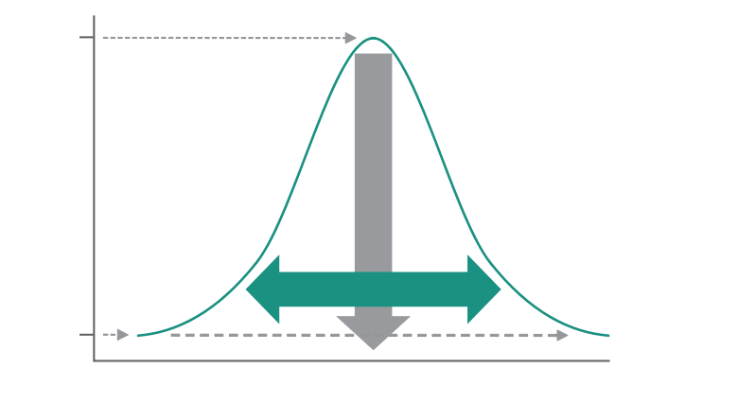
Dispersion and Variance
Measures of central tendency
Mean
Median
Mode
Measures of dispersion
Range and inter quartile range
Quartile deviation
Variance
Standard deviation
Notes:
This figure shows the normal distribution -
Clarify range, inter-quartile range, median
Use case to work through differences.

Slide 66
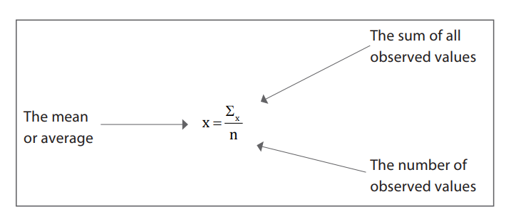
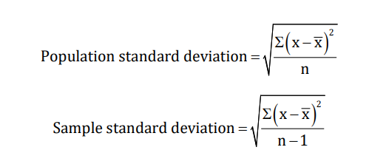
Measure of Central Tendency
Notes:
Central tendency gives a single number thetis typical of the data.

Slide 67
Dispersion and Variance
Variance
Measure of returns dipseriosn
Used to calculate Beta
Volatility
Measure of risk
Higher volatility means higher standard deviation

Slide 68
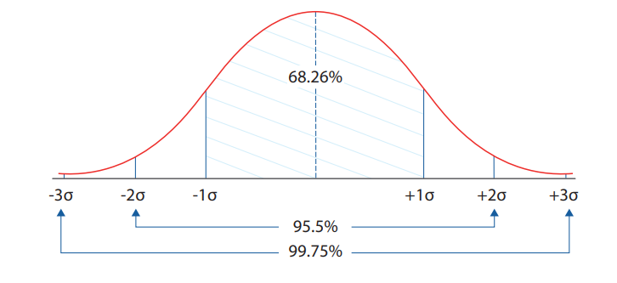
Distribution Analysis
Statistical means of using historical data to predict future events
Relies on probability distribution, such as the normal distribution
Utilises the distribution around the mean based on the number of standard deviations either side

Slide 69
Confidence Intervals and Fat Tails
Confidence intervals
Drawn from distribution analysis
For example, there is a 95.5% chance that the return will be within 2 standard deviations of the mean
Fat tailed distributions
Distributions that are not normally distributed, but skewed
Notes:
Draw example of skewed and fat tailed distributions in comparison to normal distribution

Slide 70
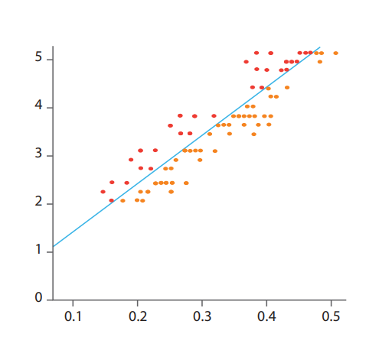
Risk Measurement and Control Concepts
Probability
Likelihood of an event occurring
Volatility
Variability of the outcome
Typically using standard deviation
Regression
Statistical tool for investigating the relationship between variables
Illustrate using a scatter-gram
Correlation coefficient
The strength of the relationship between 2 variables
Ranging from -1 (negative) to +1 (positive)
Portfolio optimisation
Notes:
Explain probability with an example - e.g. flipping a coin
Assets can be highly correlated with the market. Beta describes the relationship of the returns of the stock to the market. Alpha is the extent of outperformance against a benchmark

Slide 71
Value-at-Risk (VaR)
Maximum loss
Over a specific period
With a specified level of confidence
Market risk function sets VaR limits
Validation
Back testing is used to test accuracy
Notes:
For example of Var see workbook
Advantage of VaR is that it is easy to understand and translates all risks into a single number

Slide 72
Approaches to VaR
Historical simulation
Looking back at what actually happened
Parametric
Analytical approach assuming possible returns can be plotted based on a small number of factors
Monte Carlo Simulation Method
Generating a random set of results based on the actual underlying risk factors
Scenario and stress testing
Important because VaR does not specify how bad the situation could get
Stress tests alter one variable at a time in exceptional, but plausible ways. For example general interest rates, correlation coefficients etc
Particular scenarios can be invented (such as volatility doubling) or based on previous external factors (such as a large one day market fall)
Notes:
Consider explain stress and scenario testing by using current examples such as - testing what happens if the economy contracts, if unemployment changes etc

Slide 73
Investment Risk
Chapter 6

Slide 74
Basic Concepts & Measurements
Nominal return
Return unadjusted for inflation
Real return
Return after stripping out inflation
(1 + real rate) x (1 + inflation rate) = (1 + nominal rate)
Total return
Return from both income and capital
Holding period return
Percentage return over a particular period
Sum of income and capital gains, divided by starting value
Compound interest and time value of money
Variations in the rates of returns
Consider the variation as well as risk and time to invest
Notes:
Explain difference between simple and compound interest. Illustrate with an example.

Slide 75
Main Investment Risks
Currency risk
Arising from fluctuations in the relative value of currencies
Interest rate risk
Risk that interest rates move against the investor
Issuer risk
Risk that the issuer of bonds gets into financial difficulties
Equity risk
Growth risk, volatility risk, strategic risk of the issuing institution
Commodity risk
Risk of adverse price movements in the value of a commodity (such as gold, oil, sugar, coffee)
Property risk
Risks arising from location, use, credit quality of tenants and length of lease
Liquidity risk
Likelihood of being unable to transform assets into cash without incurring losses
Notes:
Equity returns come from capital growth and income (dividends). growth, volatility and strategic risk apply
Integrate section 2.2 on the calculation of asset and volatility risk in the explanations. Incorporate local examples if possible

Slide 76
Alpha, Beta and Key Investor Ratios
Beta – the volatility of an investment relative to the market
Beta of 1 moves in line with the market
Beta of >1 is more volatile
Beta of <1 is less volatile
Alpha – the extent of outperformance against the benchmark
Sharpe ratio and information ratio – the higher the better
Notes:
Benchmark: A standard agains which it is reasonable to compare the performance of an investment
Examples of benchmarks are peer groups, market indices, or the return on a particular risk-free asset.
Sharpe ratio uses the concept of the risk free rate of return. Risk free asset is typically a short-dated government bond in the relevant currency
Higher Sharpe ratio is better risk-adjusted performance of the portfolio
Information ratio compares excess return over the benchmark to the tracking error of the fund/portfolio. Tracking error is a measure of how closely the portfolio follows the index to which it is benchmarked.
High information ratio indicates success of fund manager

Slide 77
Illiquid Assets
Private Equity
Venture Capital
Property
Responsible Investment
Notes:
Private Equity
Equity in companies not publicly traded
Often actively managed
Venture Capital
Early stage equity investment
May attract tax relief
Lack of correlation with major asset classes
Property
Low correlation with traditional asset classes
May be subject to prolonged downturns, low liquidity and high transaction costs
Responsible Investment
Environmental concerns
Social concerns
Corporate governance concerns

Slide 78
Investment Mandate
Aims, Limits and Investment policies
Typically defines
Fund aim
Specific strategies
Geographic regions and sectors
Levels of gearing
Maximum tracking error
Mandate limits need to be managed
Wording needs to be transparent and easy to understand
Notes:
Other contents of the mandate are limits, whether it is allowed to hedge etc. Incorporate a local example of a fund and talk through the components of the mandate
Wording of the mandate should not be too specific

Slide 79
Mitigating Investment Portfolio Risk
Systematic risk
Undiversifiable
Non-systematic risk
Diversifiable by selecting stocks with low/negative correlations
Optimisation
Maximising the diversification benefits using mean-variance analysis
Portfolio hedging
Taking offsetting positions as a means of insuring against investment risk, often using derivatives such as futures and options
Short selling
Anticipating falls by selling securities that are not owned
Risk transfer
Buying or selling protection such as credit default swaps
Notes:
Systemic risk is the risk associated with the market itself.Non-systemic risk is risk that can be diversified

Slide 80
Monitoring, Managing and Reporting
Monitoring, managing and reporting is key to investment management in 4 main areas
Peer review
With other fund managers from the same firm
Risk review
By independent risk management function
Monitoring for mandate compliance
Both pre and post trade
Performance attribution reporting
Especially between asset allocation and stock selection

Slide 81
Liquidity Risk
Chapter 7

Slide 82
Constituents of Liquidity Risk
Maturity ladder
Comparing inflows and outflows
Calculating the cumulative net excess or deficit of funds at selected maturity dates
Actual and contractual cash receipts
These are likely to differ from the maturity ladder estimates due to unpredictability
For example, resale value, income received, credit risk impact
Asset liquidity risk
Risk to the cash obtained from maturity or divesting assets or using them as collateral
Funding liquidity risk
Risk to cash obtained from liabilities, such as depositors, third parties or the wholesale markets
Potential impact of liquidity risk
Inability to meet obligations as they fall due could result in insolvency
Notes:
Liquidity depends on immediate needs for cash, the amount it currently has, available lines of credit and ease with which assets can be transformed into cash
Liquidity is linked to internal and external risk factors and controls
Has similarity with operational risk - difficult to quantify.
Impaired liquidity may lead to insolvency. Use case study on page 159 and include a local example
Maturity ladder - see example on page 162
Actual and contractural cash receipts differ from maturity ladder since not all cash flows from instruments can be estimated with certainty
Use additional examples to clarify

Slide 83
Measuring Liquidity Risk
Liquidity gap analysis
Examining all net future cash flows
Gap analysis aggregates cash flows into maturity brackets (eg 0-3 mths, 3-6 mths etc)
Identifies any future negative liquidity gaps
Stress testing
Examining how inputs and outputs may change if the market is under stress
Expected future funding requirements
The result of the combination of 1 and 2 above
Notes:
See illustration on page 166. Possible to create an exercise for participants around the same
A liquidity gap is any net cashflow for a bracket.
Shortcoming: does not consider credit risk and assumes all cashflows will occur when forecast
Stress test results to be used to manage risks
Stress test can be based on historical data and/or subjective assumptions about future events
Expected future funding requirements can be based on historical patterns. statistical analysis, subjective high-level projections, and customer-by-customer assessments

Slide 84
Asset Liquidity Risk Measures
Bid offer spread
Spread divided by the mid price
The smaller it is, the more liquid the asset is
Market depth
Measure of the volume of transactions necessary to move prices
Immediacy
Time taken to achieve a deal
Resilience
Speed at which prices return to equilibrium following a large trade

Slide 85
Managing Liquidity Risk
Liquidity limits
Banks should set limits
Imposing a ceiling on projected net funding requirements across the maturity ladder
Counterparty credit limits
Counterparties could be unable to fulfil their settlement obligations
Scenario analysis
Consider the impact of a bank specific crisis and a general market crisis as well as the normal ‘going concern’ condition
Liquidity at risk
Similar to VaR – using distributions to give an idea of risk at different confidence levels
Diversification
Reducing liquidity risk by using different instruments, currencies, counterparties etc
Behavioural analysis
Predicting the behaviour, particularly of depositors eg seasonal factors
Funding methods
Avoiding concentration and spreading funding across wholesale money market, securitisation, retail deposits and central bank funding
Notes:
Use examples for scenario analysis to highlight going concern, bank specific crisis and general market crisis. (see page 171/2)
Liquidity resources should be diversified according to the tup of liquidity instruments held, currency, counterparties, liability term structure and the availability of markets
In periods of stress diversification can be compromised. Consider, for example, the financial crisis as an example

Slide 86
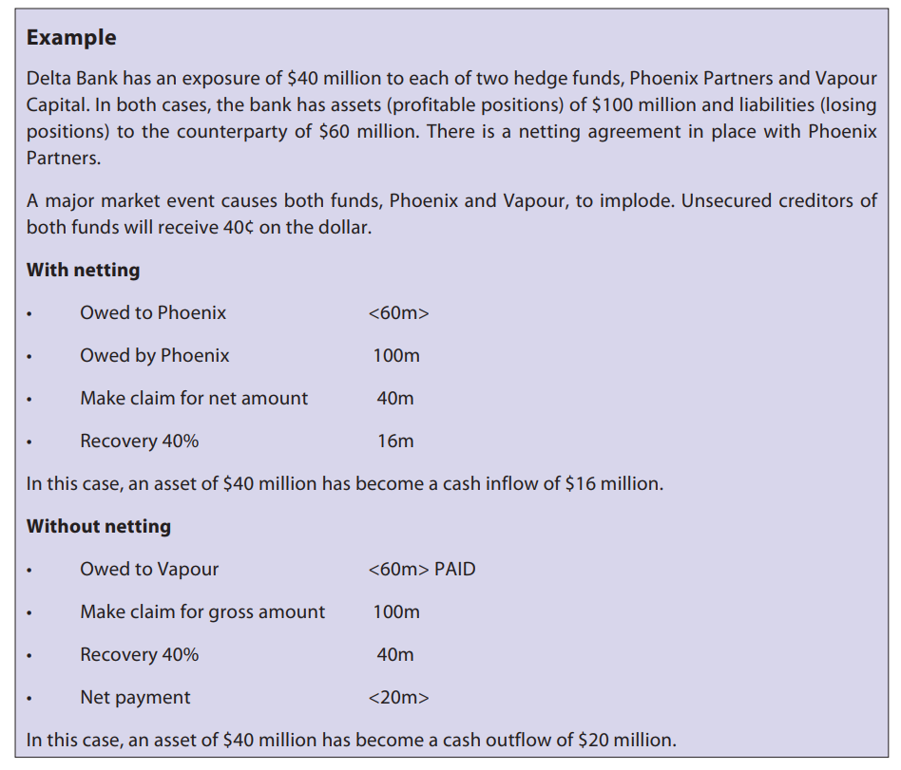
Netting Agreement Impact
Notes:
Use as case to let participants work on in groups or individually. Consider using a different example from the book

Slide 87
Market Dislocation
Markets generally work in a certain way
The price is higher when demand is high and supply is low
When liquidity disappears no-one lends at any price - market dislocation
Behaviour of markets and participants becomes unpredictable
Implications
Difficulties borrowing
Interest rates are no longer the main economic instrument
Notes:
Market dislocation is when markets don't react or behave in the way we expect. For example during the financial crisis everyone stopped lending, no matter the price

Slide 88
Model Risk
Chapter 8

Slide 89
Risk Model Types
Models are simplified representations to help make sound decisions
Typical risk models include those covered earlier:
Operational Risk Scenario Modelling
To calculate the required capital to guard against unexpected operational risk losses
Monte Carlo simulations used – multiple iterations into an implied distribution
Credit Value-at-Risk
Predicting value changes due to moving from one credit rating to another
Market Value-at-Risk
Expresses maximum market loss that can occur
Liquidity at Risk
Using maturity ladders
Notes:
Benefits of modelling is that they provide a simplified representation of complex issues
Limitations equally steam from their simplification. See case study on LTCM on chapter 8, section 1.1.1. Include other local examples.
Limiting assumptions: Shape of the underlying distribution, the relationship between past and future (history does not necessarily repeat itself) and the state of the business environment at which the model was created.
For operational risk scenario modelling explain the figure on chapter 8, section 1.2.1.
Monte carlo simulation process first derives the likelihood of the occurrence and then the impacts. See chapter 8, section 1.2.2.
Steps in market value of risk modelling are to identify the risk factors, select a sample of actual history risk factors, apply those to daily changes and list all resulting portfolio values and identify the value that represents the desired confidence interval

Slide 90
Effective Governance of Risk Modelling
Board and senior management establish a firm wide framework for model risk management
Senior management assign competent staff with clear model ownership, oversee model development and implementation and establish model risk controls (eg evaluation and review)
Internal audit assess overall effectiveness
Possible use of external resources
Policies, processes and documentation

Slide 91
Risk Oversight and Corporate Governance
Chapter 9

Slide 92
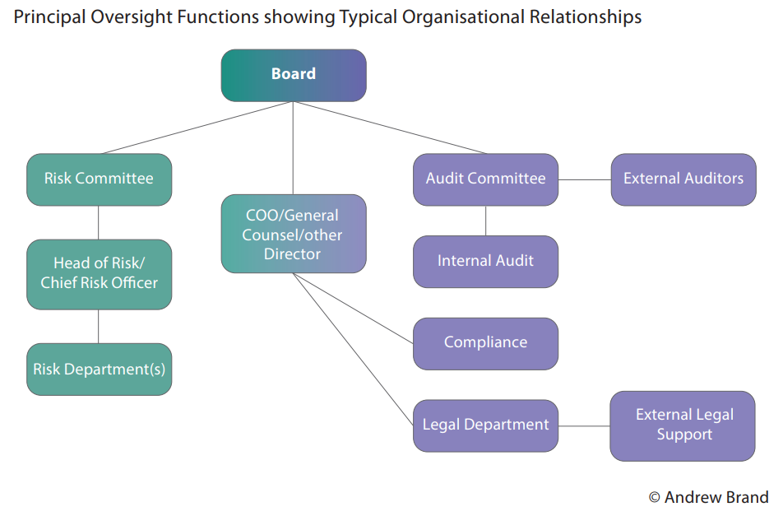
Principal Oversight Functions
Notes:
Discuss each of the components. See chapter 9, section 1.

Slide 93
Structural Framework
Risk committee recommend the amount at risk (ie risk appetite or tolerance) to the Board for approval
Amount of financial risk
Amount of non-financial risk
Board delegates authority to oversee to the risk committee
Risk committee delegates to the CRO to set business level risk
Department heads monitor risks in their business units
Notes:
Setting up the framework is not a one-off exercise, but needs to be reviewed on an on-going basis and amended as required. Any corporate changes need to take into consideration the corporate governance framework. Succession plans need to be in place for each member of the firm’s key committees

Slide 94
Structural Framework
Three lines of defence
Business management – ‘own’ risk on a day to day basis
Independent risk functions (including compliance)
Internal audit Standards on capital adequacy
Holding enough capital to overcome adverse movements
Challenges
Getting the right authority and autonomy for risk managers
Segregating between risk takers and risk managers
Proximity of risk managers to the business
Change related challenges – planned (eg mergers), unplanned (eg resignations)
Notes:
Setting up the framework is not a one-off exercise, but needs to be reviewed on an on-going basis and amended as required. Any corporate changes need to take into consideration the corporate governance framework. Succession plans need to be in place for each member of the firm’s key committees

Slide 95
Culture and Leadership
Governance and policies
Risk-focussed
From the top
Policies need to emphasis and enable focus on risk management
Risk appetite/Risk Tolerance
Adopt and affirm the firm’s risk appetite
Understanding of current risk profiles and trends
Clear connection to business strategy and capital plan
Notes:
According to Principle 12 of the BIS Corporate governance principles for banks, they need to publish information such as board structure, basic ownership structure, organisation structure, incentive structure, business conducts, conflicts of interest policy
Integrity, ethics and social responsibility is also related to the firm’s reputation and potential repetitional risk
Education is needed across the firm, but in different ways. Boards, for example, need to be given the means to understand risk management and the firm’s performance against it, staff need to understand their role in the overall process
When firms understand their risk, it is easier to manage. Organisations need to understand risk management is more than just a methodology
Moral hazard is the possibility that people wildcat differently when they are protected from the effects of the risk they take. It is, for example, easier to make a bet with money that is not yours.

Slide 96
Culture and Leadership
Transparency
Governance of the bank should be adequately transparent (BIS principle 12)
Public disclosure
Integrity, ethics and social responsibility
Education and development
Reducing risk
Moral hazard
Notes:
According to Principle 12 of the BIS Corporate governance principles for banks, they need to publish information such as board structure, basic ownership structure, organisation structure, incentive structure, business conducts, conflicts of interest policy
Integrity, ethics and social responsibility is also related to the firm’s reputation and potential repetitional risk
Education is needed across the firm, but in different ways. Boards, for example, need to be given the means to understand risk management and the firm’s performance against it, staff need to understand their role in the overall process
When firms understand their risk, it is easier to manage. Organisations need to understand risk management is more than just a methodology
Moral hazard is the possibility that people wildcat differently when they are protected from the effects of the risk they take. It is, for example, easier to make a bet with money that is not yours.

Slide 97
Enterprise Risk Management (ERM)
Chapter 10

Slide 98
Enterprise Risk Management (ERM)
Enterprise risk is the aggregation of the complete set of risks faced by the firm
Enterprise risk management is applying the discipline of risk management to all of the risks the firm faces
Also known as integrated risk management or firm-wide risk management
The responsibility of the Board and senior management
Single view of the firm’s risk
Notes:
Because ERM integrates management of all risks, corporate governance personnel can have a single view of the firm’s risk profile

Slide 99
ERM – Sound Practices and Challenges
From industry regulation, such as Basel’s Pillar 2 (ICAAP)
Links between increases in market risk, operational risk and credit risk
Exception based escalation
Data Aggregation Challenges include:
Measurement – need to ensure comparisons can be made
Timescale – linked to measurement
Combining the data
Accountability
ESG
Notes:
Industry regulations like Basel Accord Pillar 2 drives firms towards ERM type approach. First step of ICAAP is to define and quantify the firm’s overall exposure across all risk types which is what ERM tries to achieve.
All risks are managed at the appropriate level within the organisation and only exceptions are escalated.
Combining the data is challenging as it needs to distinguish between firm and client risk to ensure no double counting and/or overinflation of risk

Slide 100
Business Functions Participating in ERM
Strategic planning
Finance department
Appropriate risk departments (especially credit risk, market risk and operational risk)
Internal audit ensure the framework is accurate and robust

Slide 101
Examination
Practice and a structured approach is essential
Key points to remember:
Multiple choice style
Number of questions and time per question
Distribution of questions across workbook
Essential to read the question and options carefully
You tend to have a lot more time than you think
Need to learn key facts and their application
Practising questions is vital
Notes:
Conclude with hints and tips on examination preparation.
Ensure candidates are aware of the sample exam screens available on the CISI website and that they go through these before the exam. Consider logging in and showing these and suggesting exam tips.
The first screen looks like this.

Slide 102
Questions?

